Slide 1

Vel Tech Rangarajan Dr. Sagunthala R&D Institute of Science and Technology
School of Computing
Department of Computer Science and Engineering
10211CS224 / FULL STACK APPLICATION DEVELOPMENT (JAVA)
PROJECT REVIEW : MILESTONE PROJECT – 1
Date: 24-03-2026
Responsive E- Commerce Interface with State-Persistent Cart
Presented By:
KISHORE S – VTU24452 – 23UECS0769
Courses Handling Faculty:
Dr. HAFIZUR RAHMAN
ASSISTANT PROFESSOR

Slide 2
INTRODUCTION
1
Background of the Problem
Many e-commerce websites do not save cart items when users refresh the page or leave the website. This causes inconvenience and poor user experience during online shopping.
Importance of the Project
A responsive e-commerce system allows users to easily browse and buy products from any device. A persistent cart helps users keep their selected items without losing them.
Real-World Relevance
Online shopping is growing rapidly, and efficient cart management improves customer satisfaction and website usability.
System Overview
The proposed system is a Responsive E-Commerce Web Application with a Persistent Cart built using HTML, CSS, JavaScript , and MySQL with PHP to manage products, users, and shopping cart data efficiently.
2
3
4
5
6
7
8
9

Slide 3
PROBLEM STATEMENT
1
Problem Statement
Many e-commerce websites do not maintain cart items when users refresh the page or leave the website.
Users often lose their selected products, which leads to a poor shopping experience.
Some online stores are not fully responsive, making it difficult to use them on mobile devices.
This results in inconvenience and reduced user satisfaction during online shopping.
There is a need for a responsive e-commerce platform with a persistent cart that keeps items saved for users.
The system should provide smooth navigation, reliable cart management, and an easy shopping experience.
2
3
4
5
6
7
8
9

Slide 4
OBJECTIVE(S)
1
Objectives
1. To design and develop a responsive e-commerce web application that allows users to browse products and purchase items easily across different devices.
2. To implement a persistent shopping cart system that saves selected items even after page refresh or when the user leaves the website, improving the overall shopping experience.
2
3
4
5
6
7
8
9

Slide 5
PROPOSED SYSTEM
1
Proposed Solution:
Develop a responsive e-commerce web application for easy online shopping.
2. Provide a platform where users can browse products and add items to the cart.
3. Implement a persistent cart to save items even after page refresh or logout.
4. Allow users to search, select, and manage products easily.
5. Store and manage product and user data using a MySQL database.
6. Build a responsive interface using HTML, CSS, and JavaScript for smooth user experience.
7. Ensure simple navigation and efficient cart management for better shopping experience.
2
3
4
5
6
7
8
9

Slide 6
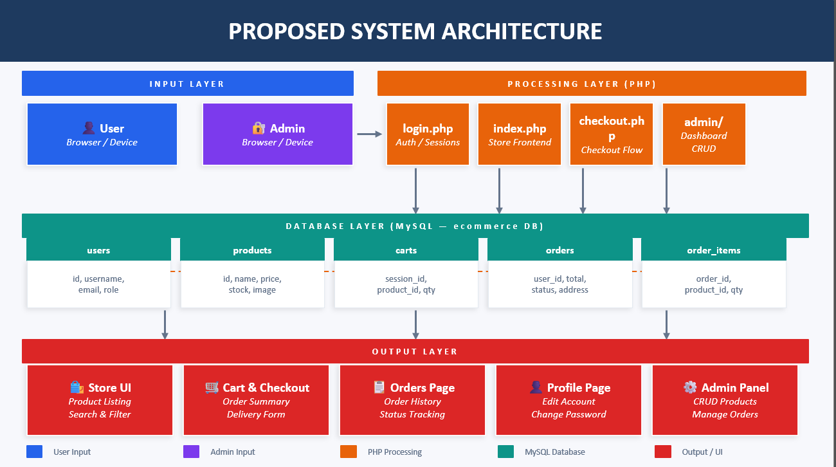
PROPOSED SYSTEM ARCHITECTURE
INPUT
Users interact via a frontend built with HTML, CSS, and JavaScript. They can register, log in, browse products, add items to the cart, and place orders.
PROCESSING
The frontend sends requests to the PHP backend server. The server handles authentication, manages cart data, and executes database operations using MySQLi prepared statements.
DATABASE
User details, product information, cart data, and order records are stored in a MySQL database named ecommerce across five tables — users, products, carts, orders, and order_items.
OUTPUT
The server sends responses to the frontend displaying products, cart items, order history, and delivery status to users, and product management with order tracking to the admin.
1
2
3
4
5
6
7
8
9

Slide 7
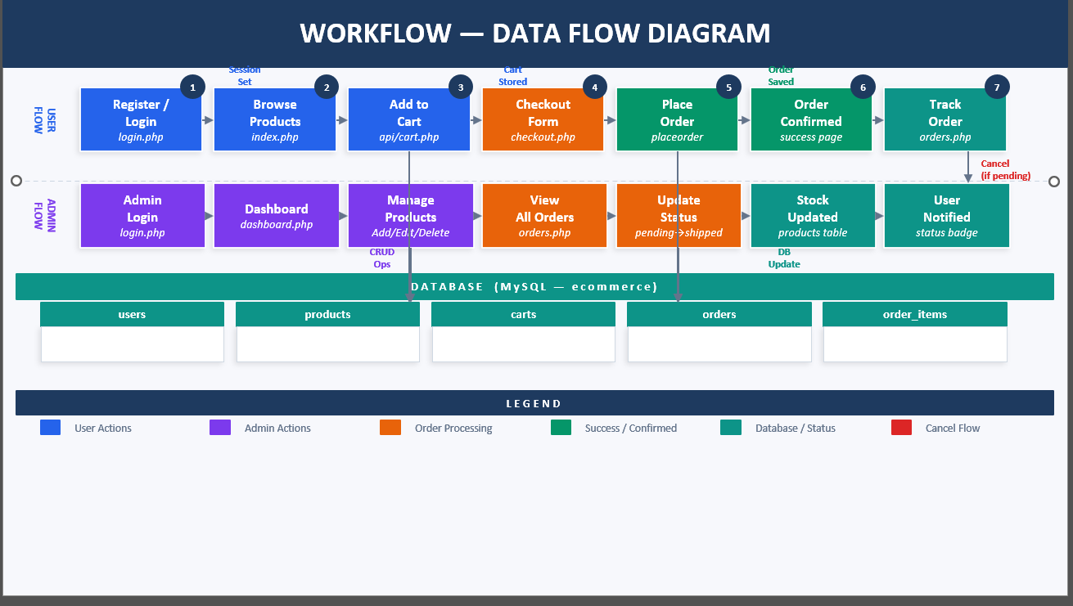
WORKFLOW
1
2
3
4
5
6
7
8
9

Slide 8
TECHNOLOGIES USED
Frontend: HTML5, CSS3, JavaScript
Backend:
phpMyAdmin , MySQLi
Database: MySQL 8
Tools: Visual Studio Code , Notepad++ , XAMPP , phpMyAdmin
Hardware/Software Requirements: Processor: Intel i3 or above RAM: 4GB minimum Operating System: Windows / Linux / macOS Web Browser: Chrome / Edge / Firefox / Safari
Space: 2GB minimum
1
2
3
4
5
6
7
8
9

Slide 9
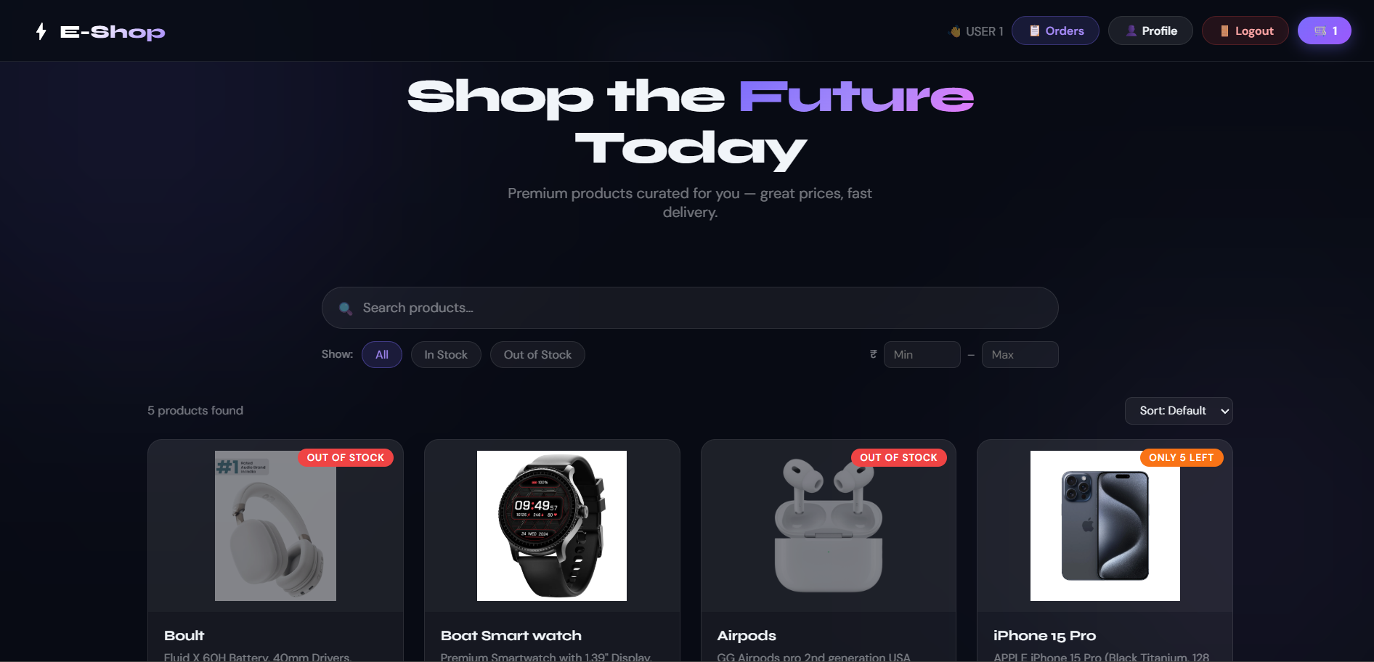
IMPLEMENTATION SCREENSHOTS
1
2
3
4
5
6
7
8
9
Module 1: Landing page

Slide 10
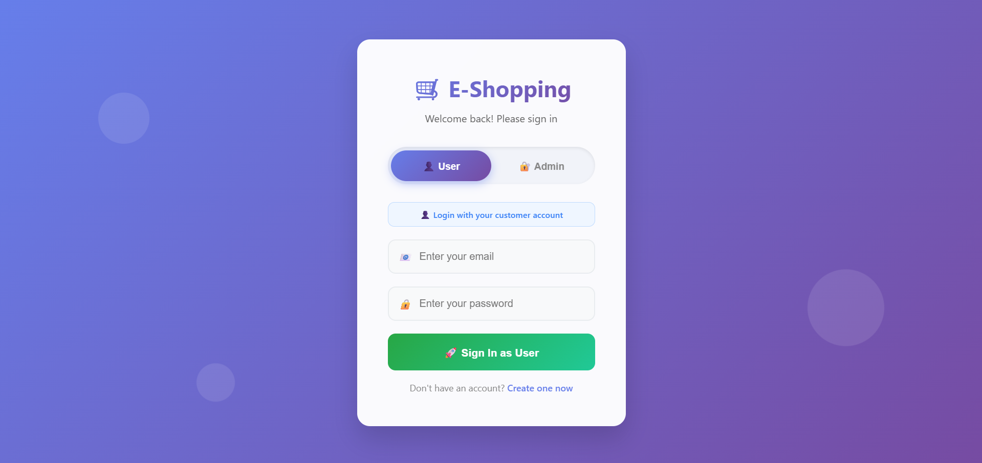
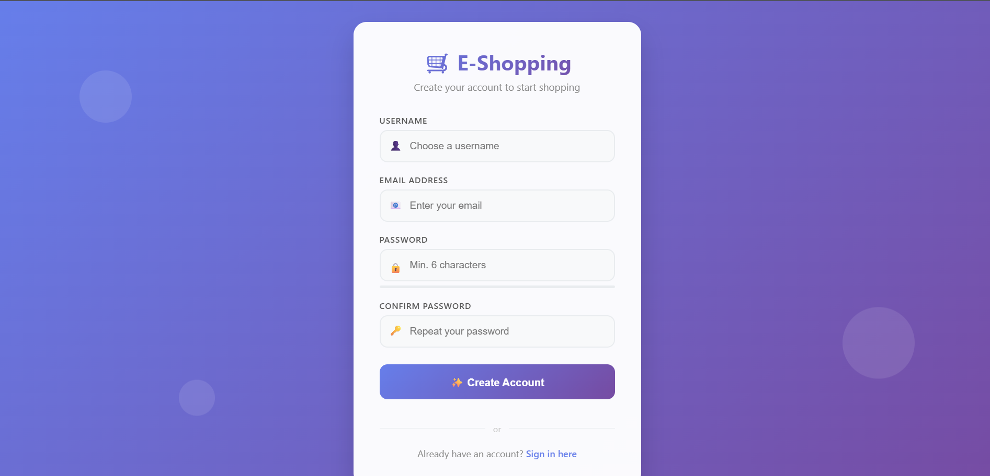
IMPLEMENTATION SCREENSHOTS
1
2
3
4
5
6
7
8(A)
9
Module 2: User Management
Handles user registration, login, and authentication for secure access to the website.

Slide 11
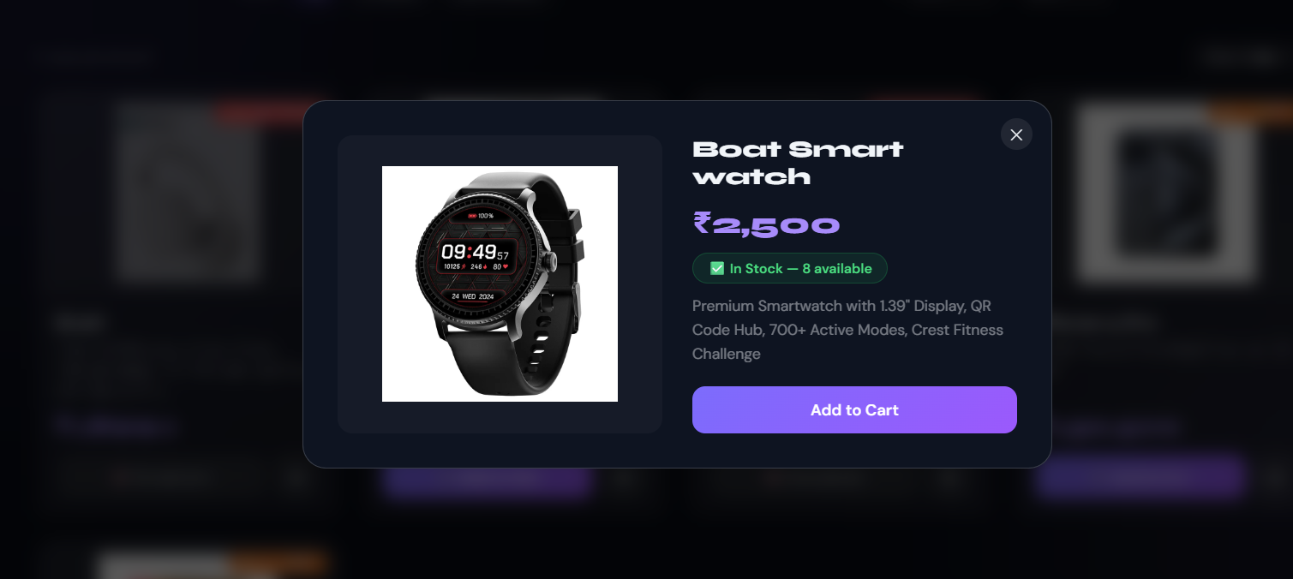
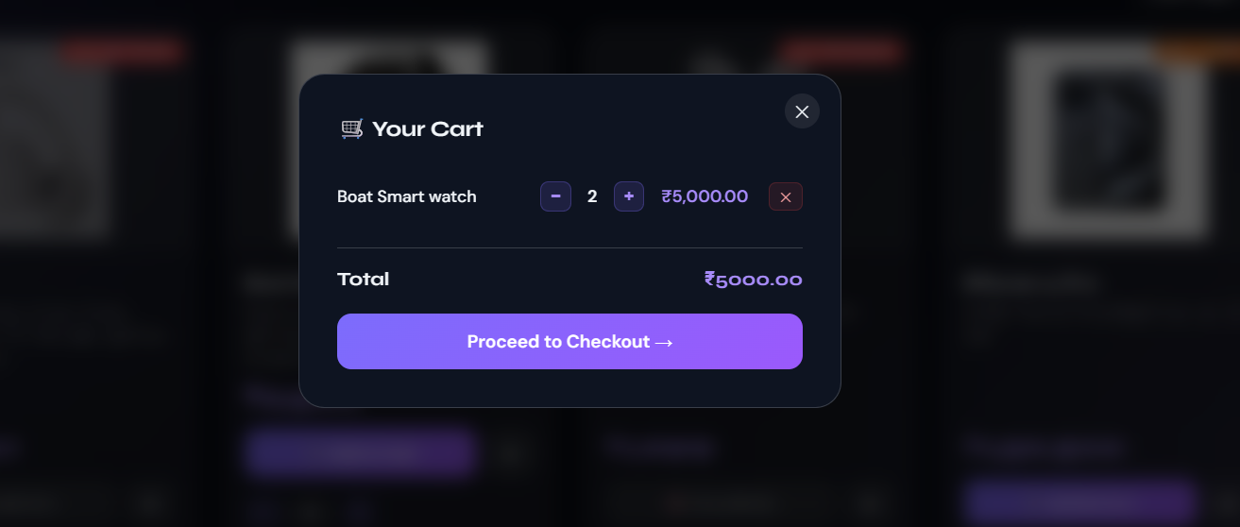
IMPLEMENTATION SCREENSHOTS
1
2
3
4
5
6
7
8(B)
9
Module 3: Product Management
Allows users to browse, search, and view products available in the online store.

Slide 12
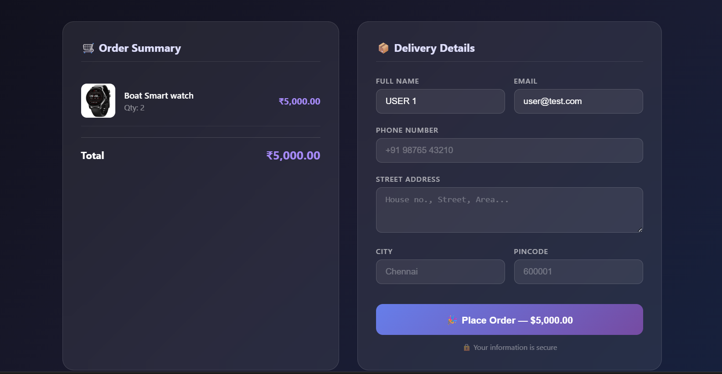
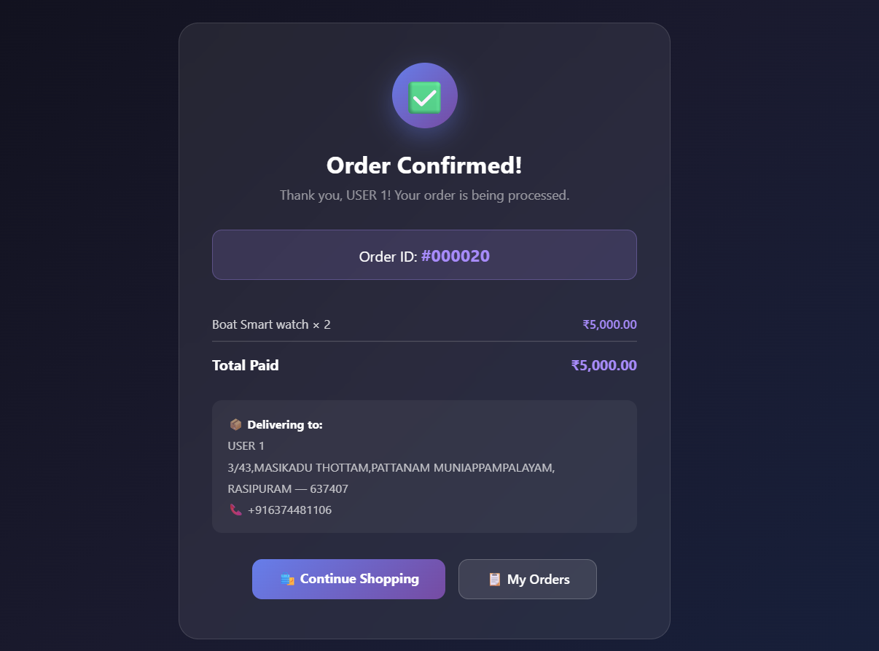
IMPLEMENTATION SCREENSHOTS
1
2
3
4
5
6
7
8(C)
9
Module 4: Checkout & Order Management
Handles the checkout process, payment, and order confirmation for purchased products.

Slide 13
ADVANTAGES & LIMITATIONS
1
ADVANTAGES:
1. Provides a user-friendly and responsive shopping interface.
2. Persistent cart saves items even after page refresh or logout.
3. Allows users to easily browse, search, and manage products.
4. Improves user experience and convenience in online shopping.
LIMITATIONS:
1.Limited features compared to large commercial e-commerce platforms.
2.Security and payment integration may need further improvement.
2
3
4
5
6
7
8
9

Slide 14
Thank you

